Slide 1

.
Banking management system
By
Jatin Yadav 1902900100072
Krishan Chhokar 1902900100084
Kamal Dev 1902900100076
Submitted To:
Department of Computer Science & Engineering
in partial fulfillment of the requirements for the degree of
B.Tech in Computer Science & Engineering (CSE).
Supervised by:
Mr. K.K Aggarwal (Department of CSE)

Slide 2
CONTENTS
1. Introduction
2. Project Requirements
3. Technologies
4. System Modules
5. Data Flow
6. Advantages & Disadvantages

Slide 3
ONLINE BANKING MANAGEMENT
Here,
1. You can create a new account,
2. Update information of an existing account,
3. View and manage transactions,
4. Check the details of an existing account,
5. Remove existing account and view customers list.
Overall, with this project, you can perform banking activities. Online Banking management mini project in C is a console application without graphics. It is compiled in Visual Studio Code (VSC).

Slide 4
TECHNOLOGY USED
C is a general-purpose, procedural computer programming language supporting structured programming, lexical variable scope, and recursion, with a static type system.
C is highly portable and is used for scripting system applications which form a major part of Windows, UNIX, and Linux operating system. C is a general-purpose programming language and can efficiently work on enterprise applications, games, graphics, and applications requiring calculations, etc.

Slide 5
SYSTEM MODULES
void transfer()
To transfer in your bank account.
void deposit()
To deposit in yout bank account.
void withdraw()
To withdraw from your bank account.
void checkdetail()
To check details of your back account.
void last()
To display the details of your bank account.

Slide 6
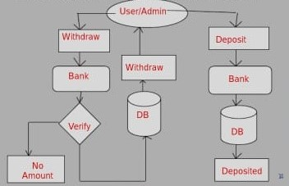
DATA FLOW

Slide 7
ADVANTAGES
Some advantages of online banking go hand-in-hand with simply being online; others are competitive advantages provided by online banks taking advantage of their cost structure. The most prominent benefits provided by online banking include:
1. 24/7 account and service access
2. Speed and efficiency
3. Online bill payment
4. Low overhead can mean low fees
5. Low overhead can mean high interest rates on deposit accounts

Slide 8
DISADVANTAGES
No one type of bank can be the best at everything. In spite of their many advantages, there are some drawbacks to using online banks as well. Here are some of the downsides of working with an online bank:
1.Technology issues
2. Security issues
3. Inefficient at complex transactions
4. No relationship with personal banker
5. Inconvenient to make deposits

Slide 9
CONCLUSION
This project demonstrate the way to develop an ONLINE BANKING SYSTEM by using interactive web client by using C.

